Slide 1
DATA VISUALIZATION ASSOCIATE INTERNSHIP
0801| GROUP 5B
DASHBOARD PRESENTATION
Helping Excelerate make data driven impactful decisions through data visualization
DS FUTURE

Slide 2
Table of contents
Selling your idea
Introduction
Overview / Visualization Highlight
Challenges Faced
Key Decisions / Solutions implemented
Key Questions / Insight Derived
Impact on Decision Making
Conclusion

Slide 3
Meet my team
Gracious Ogbeme
Firdaus Omoosumi Akorede
Osariemen Kelly Enabulele
Gurram Jeevika
Anshul Singh
Ehijie Collins Agbadu
Deborah Uchenwoke
Eberechukwu Azubuike

Slide 4
Purpose of the dashboard
Using generated data to answer Key questions
To track per performance and improvement
Identify pattern in data
To provide insights for making impactful decisions

Slide 5
Key components of the dashboard
Key metrics: Total users, total Opportunity, country, total signup, completion rate.
Visualization
Dashboard filter
Design and Formatting

Slide 6
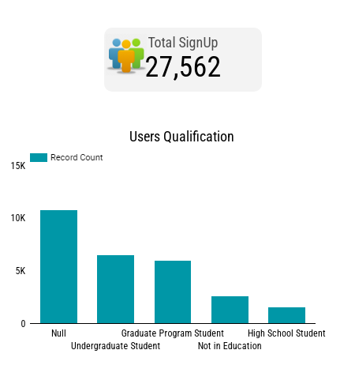
User signup

Slide 7
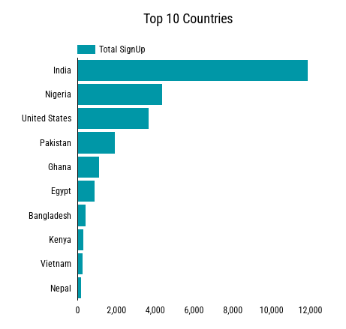
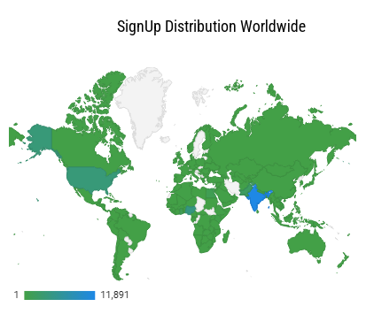
Product development

Slide 8
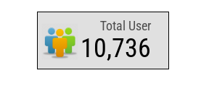
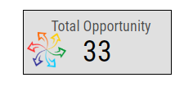
Total Opportunity
Total Users

Slide 9
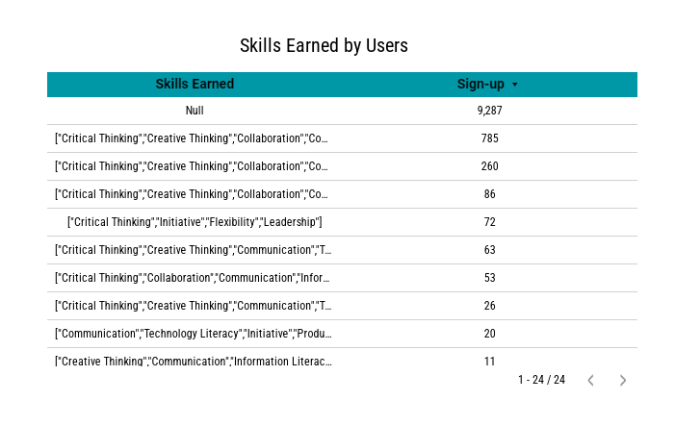
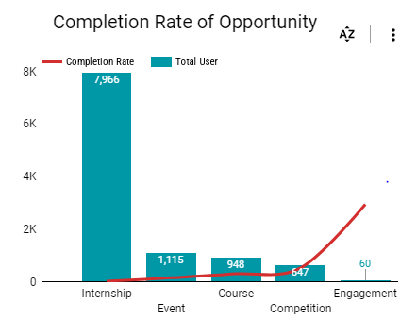
User engagement

Slide 10
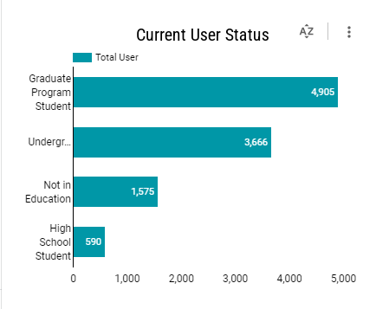
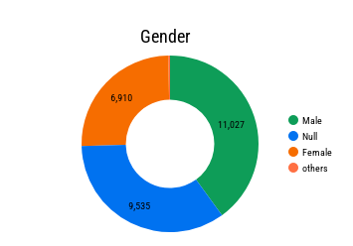
Target Audience

Slide 11
Challenges encountered
Data preparation and importation
Choice of visualization type
Interactivity
Balancing design and functionality
Creating a visually appealing design

Slide 12
Key decisions/ Solutions implemented
Data cleaning and organization
Handling null values
Data type consideration in choosing the right visualization type.
Choosing right formula and function for calculated fields to provide accurate data.
Employing visually appealing layout and design.

Slide 13
Key questions and insights derived
Skills earned
Users qualification
US city insights
Signup cities in India
Social media signups
Current student status
Completion rate of opportunity
Global distribution( the top 10 countries)
Reward amount by country and opportunity name
Demographic analysis section using gender and current student status.
Time series: signup overtime

Slide 14
Impact on Decision Making
Consciously planned timely future marketing campaigns.
Localized programme development for target outreach in the US.
Tailoring marketing Campaigns accordingly in high and low populated cities in India.
Sign up from social media.
Marketing and Advertising campaigns

Slide 15

Conclusion
Thank you for listening

